Slide 1
OPHTHALMOLOGY
For House officers

Slide 2
Outline
The Eye Examination
Acute Visual Loss
Chronic Visual Loss
Red Eye
Ocular and Orbital Injuries
Amblyopia & Strabismus
Neuro-Ophthalmology
Ocular Manifestations of Systemic Disease
Drugs and the Eye

Slide 3
The Eye Examination

Slide 4
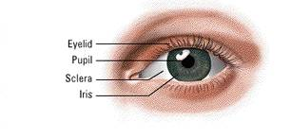
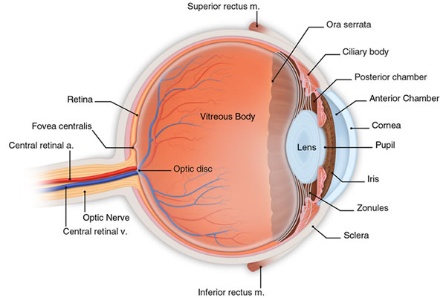
Anatomy

Slide 5
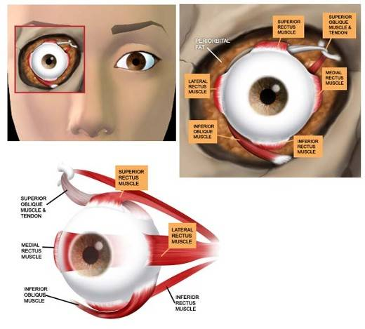
Anatomy
Extraocular movements
Medial
Lateral
Upward
Downward
Incyclotorsion
Excyclotorsion

Slide 6
Basic Physical Exam
General physical examination should include :
Visual acuity
Pupillary reaction
Extraocular movement
Direct ophthalmoscope
Dilated exam (in case of visual loss or retinal pathology)

Slide 7
Visual Acuity
Distance or Near
Distance visual acuity at age 3
early detection of amblyopia
Terminology
VA - Visual acuity
OD - ocular dexter
OS - ocular sinister
OU - oculus uterque

Slide 8
Distance Visual Acuity Testing
Nomenclature:
Distance between the patient and the eye chart
_____________________________________________
Distance at which the letter can be read by a person with normal acuity
Normal: 20/20 = 6/6
Below normal: 20/40, 20/400
Better than normal: 20/15

Slide 9
Distance Visual Acuity Testing
Place patient at 20 ft from Snellen chart
OD then OS
VA is line in which > ½ letters are read
Pinhole if < 20/40

Slide 10
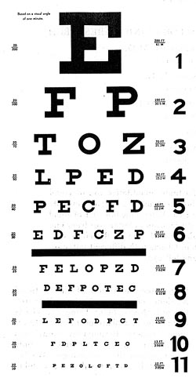
Snellen eye chart

Slide 11
Distance Visual Acuity Testing
If VA < 20/400
Reduce the distance between the pt and the chart and record the new distance (eg. 5/400)
If < 5/400
CF – count fingers (include distance)
HM – hand motion (include distance)
LP – light perception
NLP – no light perception

Slide 12
Near Visual Acuity Testing
Indicated when
Patient complains about near vision
Distance testing difficult/impossible
Distance specified on each card (35cm)

Slide 13
Pupillary Examination
Direct penlight into eye while patient looking at distance
Direct
Constriction of ipsilateral eye
Consensual
Constriction of contralateral eye

Slide 14
Ocular Motility
Rt superior rectus Lt inferior oblique |  | Lt superior rectus Rt inferior oblique
Rt lateral rectus Lt medial rectus |  | Lt lateral rectus Rt medial rectus
Rt inferior rectus Lt superior oblique |  | Lt inferior rectus Rt superior oblique

Slide 15
Direct Ophthalmoscopy
Tropicamide or phenylephrine for dilation
unless shallow anterior chamber
unless under neurological evaluation
Use own OD to examine OD
Same for OS

Slide 16
Summary of steps in eye exam
Visual Acuity
Pupillary examination
Visual fields by confrontation
Extraocular movements
Inspection of
Lids and surrounding tissue
Conjunctiva and sclera
Cornea and iris
Anterior chamber depth
Lens clarity
Tonometry
Fundus examination
Disc
Macula
Vessels

Slide 17
Acute Visual Loss

Slide 18
History
Examination
Age
POH & PMH
Onset
Duration
Severity of visual loss compared to baseline
Monocular vs. binocular ?
Any associated symptoms
Visual acuity assessment
Visual fields
Pupillary reactions
Penlight or slit lamp examination
Intraocular pressure
Ophthalomoscopy
- red reflex
- assessment of clarity of media
- direct inspection of the fundus

Slide 19
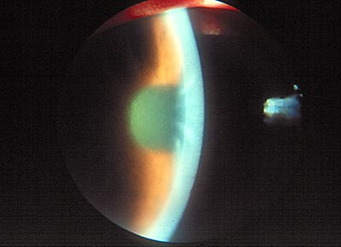
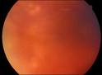
Media Opacities
Corneal edema:
Ground glass appearance
Rule out: acute angle closure glaucoma
Corneal abrasion
Hyphema
Traumatic, spontaneous
Vitreous hemorrhage
Darkening of red reflex with clear lens, AC and cornea
Traumatic
Retinal neovascularization

Slide 21
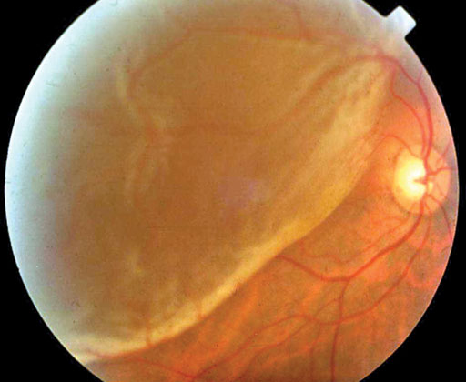
Retinal Diseases
Retinal detachment
Flashes, floaters, shade over vision
RAPD (if extensive RD)
elevated retina +/- folds
Macular disease
Decreased central vision
Metamorphopsia

Slide 22
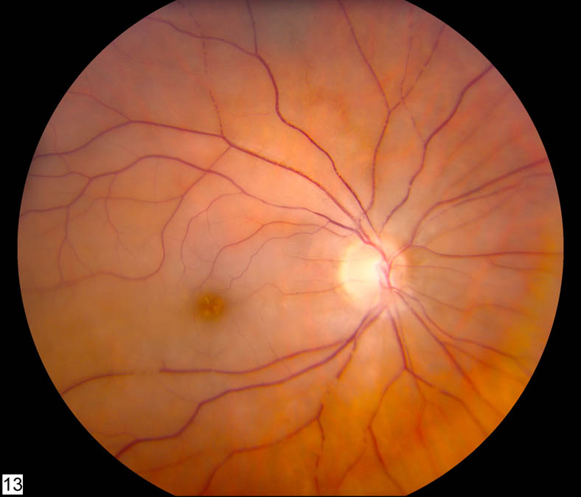
Central Retinal Artery Occlusion (CRAO)
True ophthalmic emergency!
Sudden painless and often severe visual loss
Permanent damage to the ganglion cells caused by prolonged interruption of retinal arterial blood flow
Characteristic “ cherry-red spot ”
No optic disc swelling unless there is ophthalmic or carotid artery occlusion
Months later, pale disc due to death of ganglion cells and their axons

Slide 23
CRAO Treatment
Ocular massage:
To dislodge a small embolus in CRA and restore circulation
Pressing firmly for 10 seconds and then releasing for 10 seconds over a period of ~ 5 minutes
Ocular hypotensives, vasodilators, paracentesis of anterior chamber
R/O giant cell arteritis in elderly patient without a visible embolus

Slide 24
Branch Retinal Artery Occlusion (BRAO)
Sector of the retina is opacified and vision is partially lost
Most often due to
embolus
Treat as CRAO

Slide 25
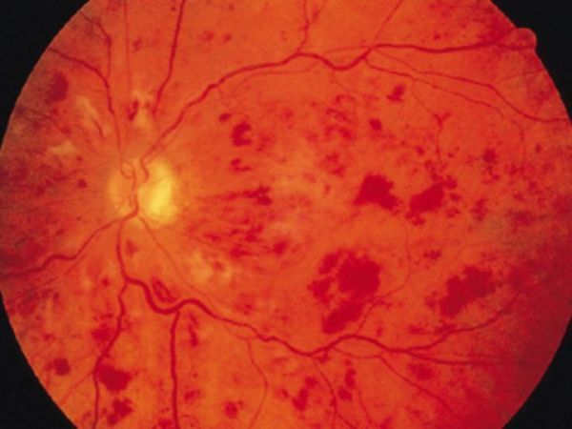
Central Retinal Vein Occlusion (CRVO)
Subacute loss of vision
Disc swelling, venous engorgement, cotton-wool spots and diffuse retinal hemorrhage.
Risk factors: age, HTN, arteriosclerotic vascular disease, conditions that increase blood viscosity (polycythemia vera, sickle cell disease, lymphoma , leukemia)
Needs medical evaluation
Long term risk for neovascular glaucoma, so periodic ophtho exm.

Slide 26
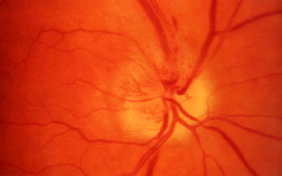
Optic Nerve Disease
Non-Arteritic Ischemic Optic Neuropathy (NAION)
Vascular disorder
Pale, swollen disc +/– splinter hemorrhage
Loss of VA , VF ( often altitudinal )
Arteritic Ischemic Optic Neuropathy (AION)
Symptoms of giant cell arteritis
ESR, CRP, Platelets +/– TABx
Rx : systemic steroids

Slide 27
Optic Nerve Disease
Optic neuritis
Idiopathic or associated with multiple sclerosis
Young adults
Decreased visual acuity and colour vision
RAPD
Pain with ocular movement
Bulbar (disc swelling) or retrobulbar (normal disc)
Traumatic optic neuropathy
Direct trauma to optic nerve
Indirect : shearing force to the vascular supply

Slide 28
Visual Pathway Disorders
Hemianopia
Causes: vascular or tumors
Cortical Blindness
Extensive bilateral damage to cerebral pathways
Normal pupillary reactions and fundi

Slide 29
Chronic Visual Loss

Slide 30
Introduction
Age-Related Macular Degeneration
Cataract
Glaucoma
Diabetes

Slide 31
Introduction
According to WHO estimates, the most common causes of blindness around the world in 2002 were:
cataracts (47.9%)
glaucoma (12.3%)
age-related macular degeneration (8.7%)
corneal opacity (5.1%)
diabetic retinopathy (4.8%)
childhood blindness (3.9%)
trachoma (3.6%)
onchocerciasis (0.8%)

Slide 32
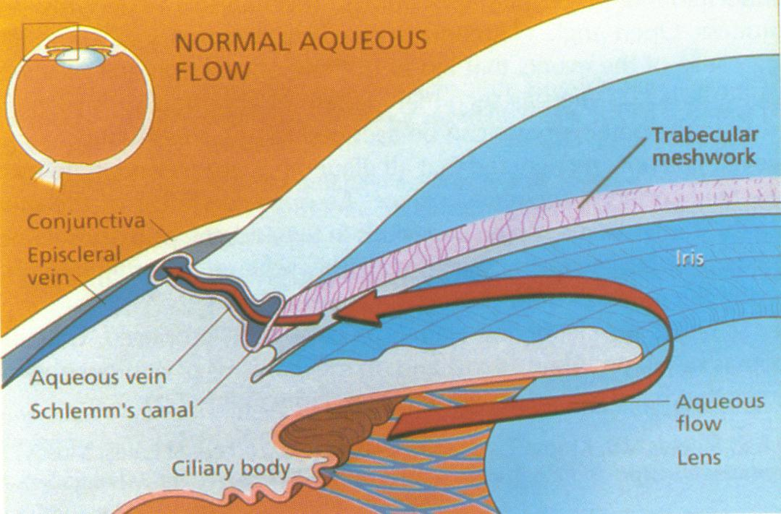
Glaucoma
Classification:
Open-angle glaucoma vs. angle-closure glaucoma
Primary vs. Secondary

Slide 33
Glaucoma
Risk factors:
Old age
Myopia
Systemic Hypertension
Family History
High IOP
Smoking

Slide 34
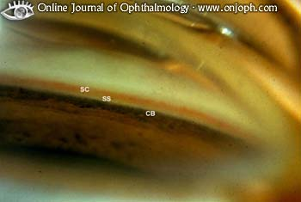
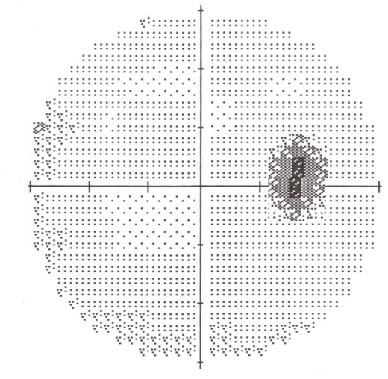
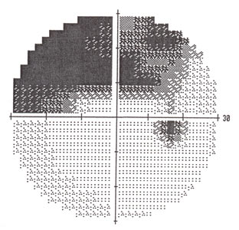
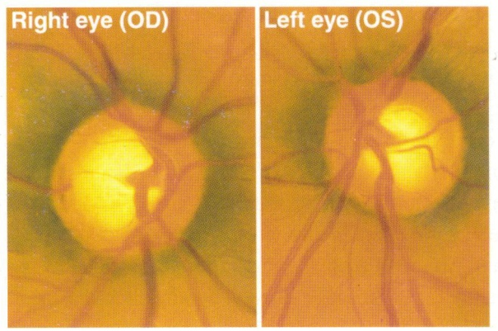
Glaucoma Evaluation
Complete history
Complete examination
IOP
Gonioscopy
Optic disc
Visual Fields

Slide 35
Glaucoma Therapy
Medical
Laser
Surgical
Surgical
Cyclodestructive procedures

Slide 36
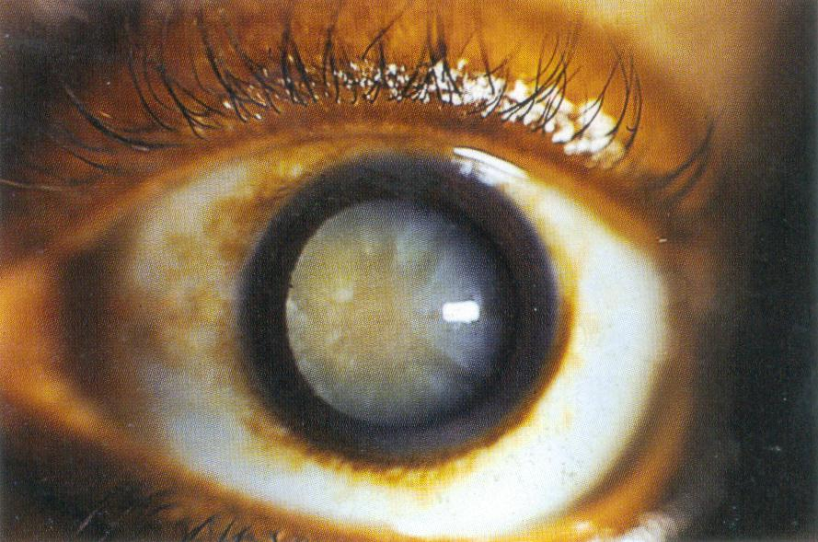
Cataract
Opacification of the lens
Congenital vs. acquired
Often age-related
Different forms
Nuclear, cortical, PSCC
Very successful surgery

Slide 37
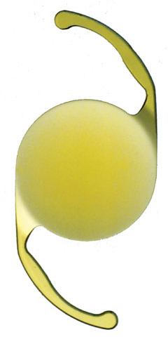
Cataract
History
Ocular Examination
Others: A-scan, ± B-scan , ± PAM
Treatment
Surgical
Excision and IOL implantation

Slide 38
Age-Related Macular Degeneration (ARMD)
Two types
Wet
Choroidal Neovascularization
Dry
Drusen
RPE changes (atrophy, hyperplasia)

Slide 39
Neovascular / Wet ARMD
CNV – choroidal neovastcularization
Leaks
Bleeds
Severe visual loss
Treatment
Laser
Injections of anti-VEGF

Slide 40
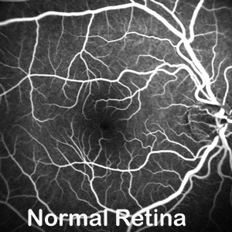
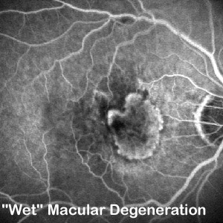
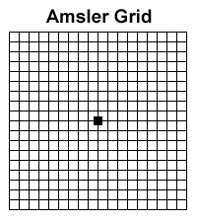
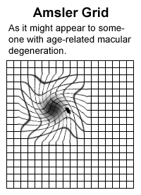

Slide 41
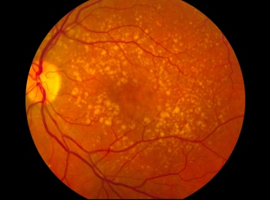
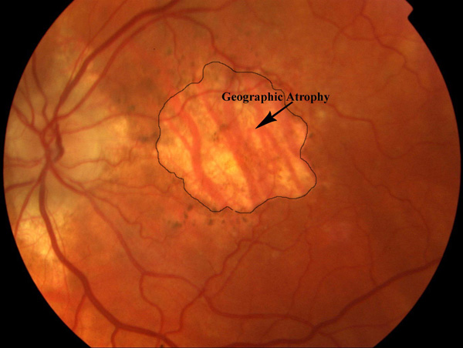
Dry ARMD
Drusen
No neovascular membrane
Atrophy of the RPE
Treat with Vitamins (!)
Vit C & E, β-carotene, minerals (cupric oxide & zinc oxide)
Omega-3

Slide 42
The Red Eye

Slide 43
DDx Red Eye
Acute angle closure glaucoma
Iritis or iridocyclitis
Herpes simplex keratitis
Conjunctivitis (bacterial, viral, allergic, irritative)
Episcleritis
Soft contact lens associated
Scleritis
Adnexal Disease (dacryocystitis, stye, blepharitis, lid lesions, thyroid..)
Subconjunctival hemorrhage
Pterygium
Keratoconjunctivitis sicca
Abrasions or foreign bodies
Corneal ulcer
2’ to abnormal lid function
THINK
Anatomy “front to back”
Acute vs. chronic
Visually threatening?

Slide 44
History
Onset? Sudden? Progressive? Constant?
Family/friends with red eye?
Using meds in eye?
Trauma?
Recent eye surgery?
Contact lens wearer?
Recent URTI?
Decreased VA? Pain? Discharge? Itching? Photophobia? Eye rubbing?
Other symptoms?

Slide 45
Red Eye: Symptoms
*Decreased VA (inflamed cornea, iridocyclitis, acute glaucoma)
*Pain (keratitis, ulcer, iridocyclitis, acute glaucoma)
*Photophobia (iritis)
*Colored halos (acute glaucoma)
Discharge (conj. or lid inflammation, corneal ulcer)
Purulent/mucopurulent: Bacterial
Watery: Viral
Scant, white, stringy: allergy, dry eyes
Itching (allergy)
* can indicate serious ocular disease

Slide 46
Physical Exam
Vision
Pupil asymmetry or irregularity
Inspect:
pattern of redness (heme, injection, ciliary flush)
Amount & type of discharge
Corneal opacities or irregularities
AC shallow? Hypopyon? Hyphema?
Fluorescein staining
IOP
Proptosis? Lid abnormality? Limitation EOM?

Slide 47
Red Eye: Signs
*Ciliary flush (corneal inflammation, iridocyclitis, acute glaucoma)
Conjuctival hyperemia (nonspecific sign)
*Corneal opacification (iritis, corneal edema, acute glaucoma, keratitis, ulcer)
*Corneal epithelial disruption (corneal inflammation, abrasion)
*Pupil abnormality (iridocyclitis, acute glaucoma)
*Shallow AC (acute angle closure glaucoma)
*Elevated IOP (iritis, acute glaucoma)
*Proptosis (thyroid disease, orbital or cavernous sinus mass, infection)
Preauricular LN (viral conjunctivitis, Parinaud’s oculoglandular syndrome)
* can indicate serious ocular disease

Slide 48
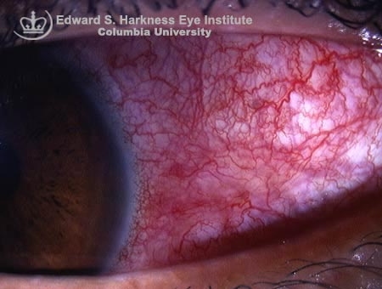
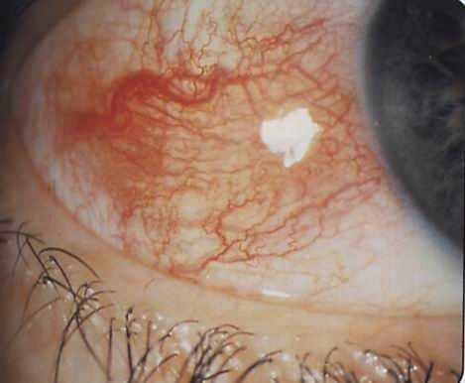
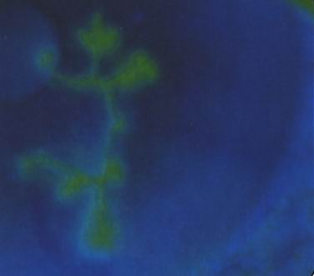
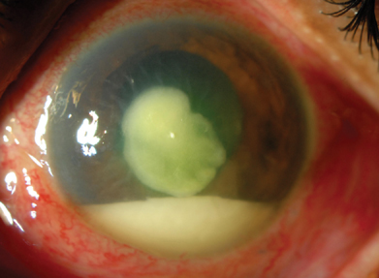
Scleritis
Episcleritis
HSV Keratitis
Corneal Ulcer with hypopyon

Slide 49
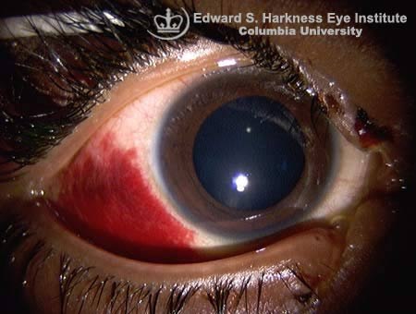
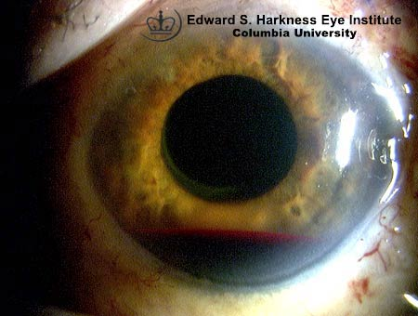
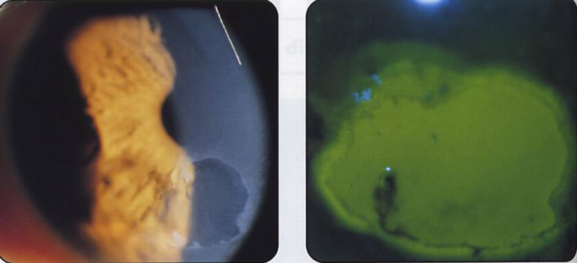
Subconj hemorrhage
Hyphema
Corneal abrasion with & without fluorescein

Slide 50
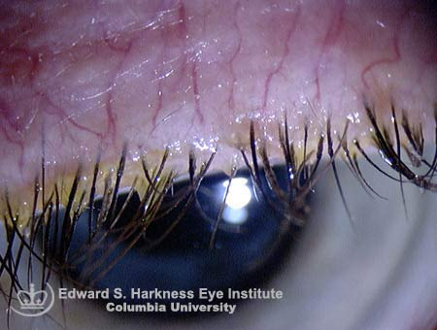
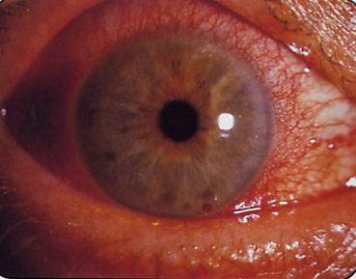
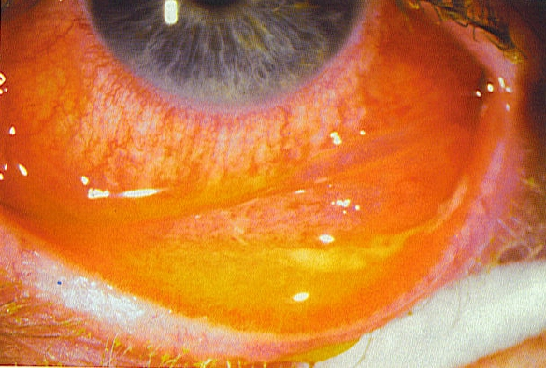
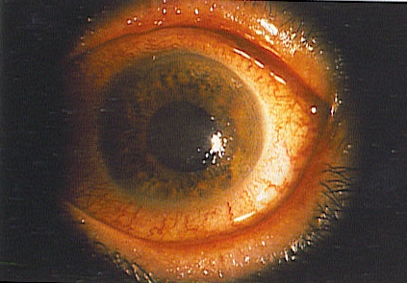
Blepharitis
Iritis
Conjunctivitis
Acute angle closure glaucoma

Slide 51
Red eye management for 1° care physicians
Blepharitis:
Warm compresses, lid care, Abx ointment or oral (if rosacea or Meibomian gland dysfunction)
Stye/Chalazion
Warm compresses (refer if still present after 1 month)
Subconj heme:
Will resolve in 10-14 days
Viral conjunctivitis
Cool compresses, tears, contact precautions
Bacterial conjunctivitis
Cool compresses, antibiotic drop/ointment

Slide 52
Important Side Effects
Topical anesthetics:
Not to be used except for aiding in exam
Inhibits growth & healing of corneal epithelium
Possible severe allergic reaction
Decrease blink reflex: exposure to dehydration, injury, infection
Topical corticosteroids:
Can potentiate growth of herpes simplex, fungus
Can mask symptoms
Cataract formation
Elevated IOP

Slide 53
Thank you

Slide 54
Ocular & Orbital Injuries
Chapter

Slide 55
Anatomy & Function
Bony orbit
Globe, EOM, vessels, nerves
Rim protective
“Blow out” fracture
Medial fracture -> subQ emphysema of eyelids

Slide 56
Anatomy & Function
Eyelids
Reflex closing when eyes threatened
Blinking rewets the cornea
Tear drainage
CN VII palsy -> exposure keratopathy
Lacrimal apparatus
Tear drainage occurs at medial canthus
Obstruction -> chronic tearing (epiphora)

Slide 57
Anatomy & Function
Conjunctiva & cornea
Quick reepitheliization post-abrasion
Iris & ciliary body
Blunt trauma -> pupil margin nick (tear)
Blunt trauma -> hyphema
Blunt trauma -> iritis
(pain, redness, photophobia, miosis)

Slide 58
Anatomy & Function
Lens
Cataract
Lens dislocation (ectopia lentis)
Vitreous humor
Decreased transparency
(hemorrhage, inflammation, infection)
Retina
Hemorrhage
Macular damage (reduce visual acuity)

Slide 59
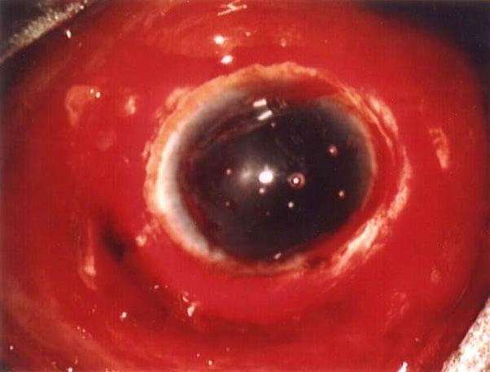
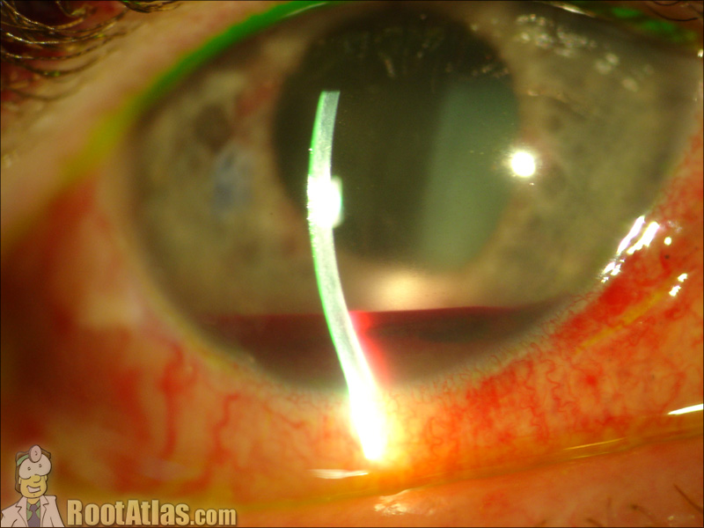
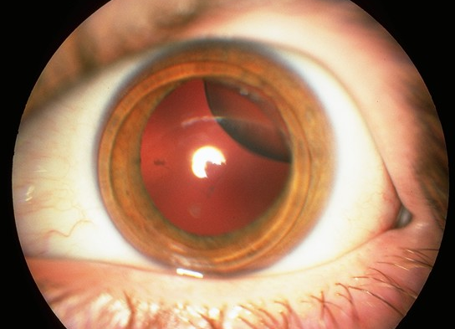
Ruptured Globe
Hyphema
Dislocated lens

Slide 60
Management or Referral
Chemical burn
Alkali worsen than Acid
Why? more rapid penetration of alkali
OPHTHALMIC EMERGENCY
ALL chemical burns require immediate and perfuse irrigation, THEN ophtho referral

Slide 61
Urgent Situations
Penetrating injuries of the globe
Conjunctival or corneal foreign bodies
Hyphema
Lid laceration (sutured if not deep and neither the lid margin nor the canaliculi are involved)
Traumatic optic neuropathy
Radiant energy burns (snow blindness or welder’s burn)
Corneal abrasion

Slide 62
Semi-urgent Situation
Orbital fracture
Subconjuctival hemorrhage in blunt trauma
Refer patient within 1-2 days

Slide 63
Treatment Skills
Ocular irrigation
Foreign body removal
Eye meds (cycloplegics, antibiotic ointment, anesthetic drops and ointment)
Patching (pressure patch, shield)
Suturing for simple eyelid skin laceration

Slide 64
Take-home Points
Teardrop-shaped pupil & flat anterior chamber in trauma are associated with perforating injury
Avoid digital palpation of the globe in perforating injury
In chemical burn patient immediate irrigation is crucial as soon as possible
Traumatic abrasions are located in the center or inferior cornea due to Bell’s phenomenon
Know and respect your limits

Slide 65
Amblyopia & Strabismus
Chapter

Slide 66
Amblyopia
Definition
Loss of VA not correctable by glasses in otherwise healthy eye
2% in US
Causes:
Strabismic (50%) > refractive > deprivation
The brain selects the better image and suppresses the blurred or conflicting image
Cortical suppression of sensory input interrupts the normal development of vision

Slide 67
Strabismus
Misalignment of the two eyes
Absence of binocular vision
Concomitant: angle of deviation equal in all direction
EOM: normal
Onset: childhood
Rarely caused by neurological disease <6 years
Can be due to sensory deprivation
Incomitant: angle of deviation varies with direction of gaze
EOM : abnormal
**Paralytic : CN, MG **
Restrictive: orbital disease, trauma

Slide 68
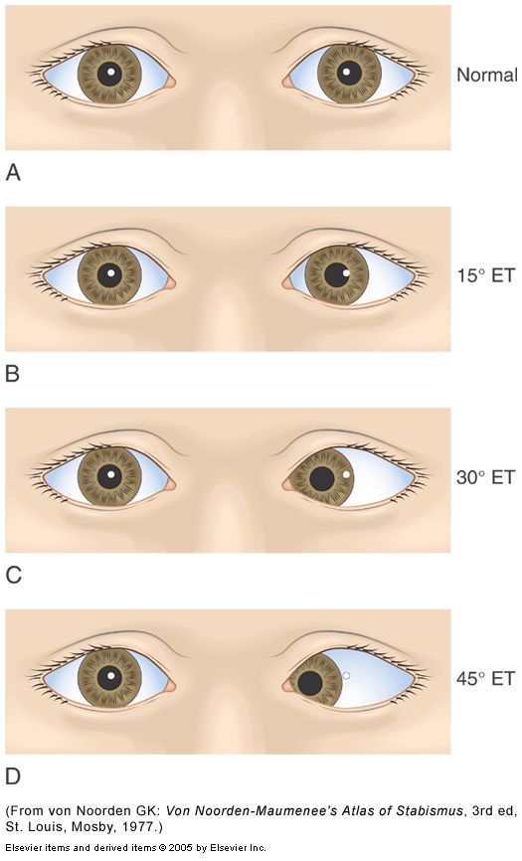
Corneal Light Reflex

Slide 70
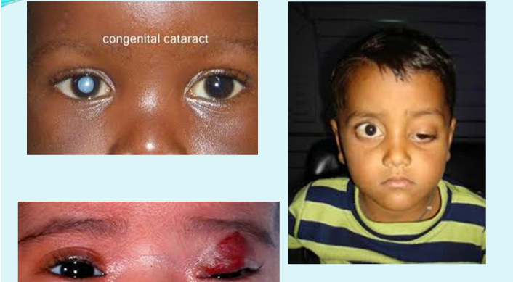
Pediatric HO

Slide 71
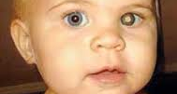
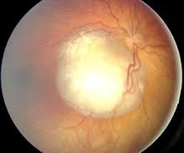


Slide 72
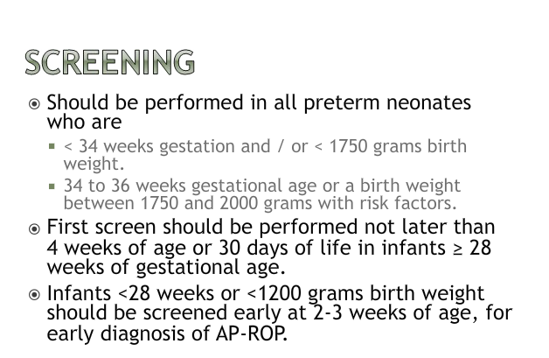

Slide 73
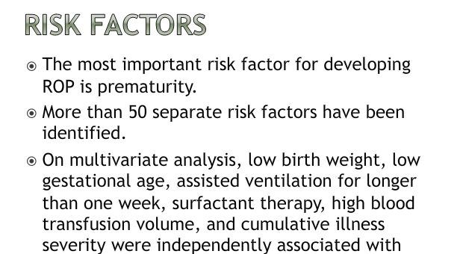

Slide 74
Neuro-Ophthalmology
Chapter
**35% of the sensory fibers entering the brain are in the optic nerves and 65% of intracranial disease exhibits neuro-ophthalmic signs or symptoms**

Slide 75
Neuro-Ophthalmic Exam
Visual acuity
Confrontation visual fields
Pupil size and reaction
Efferent vs Afferent (Marcus Gunn) problem
Ocular motility
Strabismus, limitation and nystagmus
Fundus exam
Optic nerve swelling and spontaneous venous pulsations

Slide 76
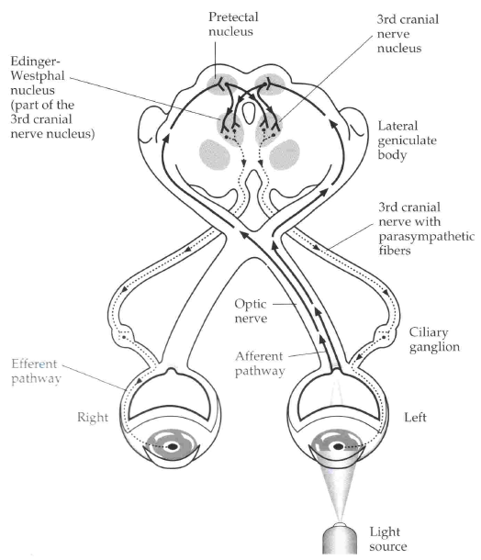
Parasympathetic

Slide 77
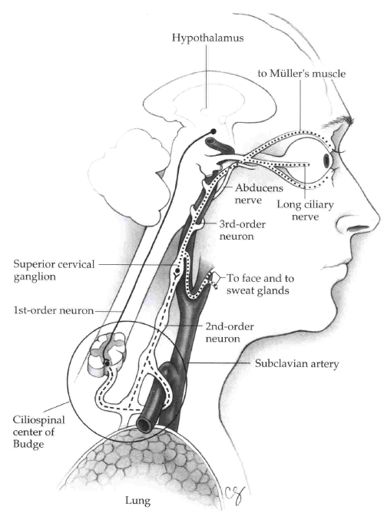
Sympathetic

Slide 78
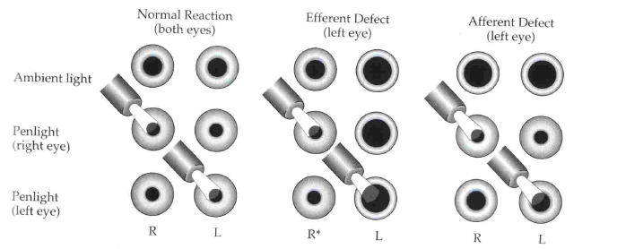
Efferent vs Afferent defect

Slide 79
Selected Pupillary Disorders
Mydriasis
CN III palsy
Herniation of temporal lobe or Aneurysm
Adie’s Tonic Pupil
Young women, unilateral, sensitive to dilute pilocarpine, benign
Miosis
Physiologic
Horner’s Syndrome
Etiologic localization (cocaine and hydroxyamphetamine)
Argyll Robertson Pupil of tertiary syphilis
small, irregular, reacts to near stimulus only

Slide 80
Selected Motility Disorders
True diplopia is a binocular phenomenon
Etiologies of monocular diplopia?
Do not forget to check ALL cranial nerves (esp V/VII/VIII)
CN IV
Vertical diplopia, head tilt toward OPPOSITE side
Think closed head trauma or small vessel disease
Myasthenia Gravis
Chronic autoimmune condition affecting skeletal muscle neuromuscular transmission (verify with Tensilon test)
Can mimic any nerve palsy and often associated with ptosis
NEVER affects pupil

Slide 81
CN III Palsy
PCOM Aneurysm
Brain Tumor
Trauma
HTN
Diabetes

Slide 82
CN VI Palsy
Trauma
Elevated ICP
Viral infections

Slide 83
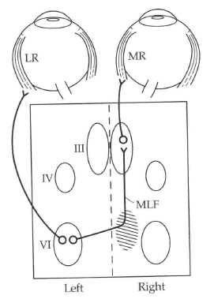
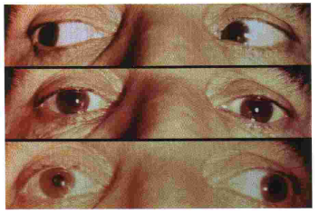
Internuclear Ophthalmoplegia (INO)
Elderly: small vessel disease
Young Adult: MS
Child: Pontine Glioma

Slide 84
Nystagmus – Selected Types
May be benign or indicate ocular and/or central nervous system disease
Definition according to fast phase
End-point Nystagmus
Seen only in extreme positions of eye movement
Drug-induced Nystagmus
Anticonvulsants, Barbiturates/Other sedatives
Searching/Pendular Nystagmus
Common with congenital severe visual impairment
Nystagmus associated with INO

Slide 85
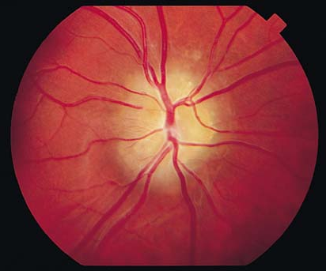
Selected Optic Nerve Diseases
Congenital Anomalous Disc Elevation
Absence of edema, hemorrhage
Presence of SVP
Consider:
Optic disc drusen
Hyperopia

Slide 86
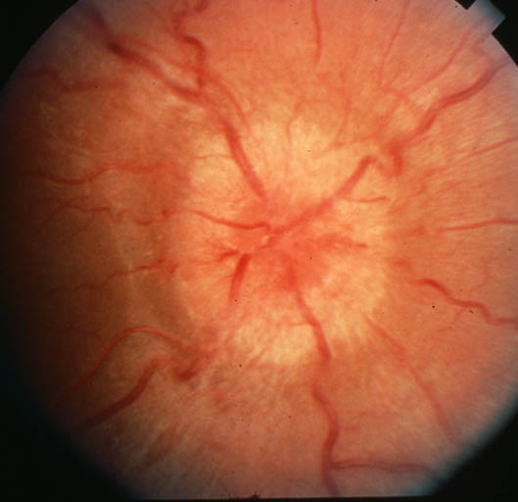
Selected Optic Nerve Diseases
Papilledema
Presence of bilateral edema, hemorrhage
Absence of SVP
Consider
Hypertension (must check BP)
Brain tumor
Papillitis/Anterior Optic Neuritis
Unilateral edema, hemorrhage
Consider
inflammatory

Slide 87

Selected Optic Nerve Disease
Optic Atrophy
Consider:
Previous optic neuritis
Previous ischemic optic neuropathy
Long-standing papilledema
Optic nerve compression by a mass lesion
Glaucoma

Slide 88

Selected Optic Nerve Disease
Ischemic Optic Neuropathy
Pallor, swelling, hemorrhage
Altitudinal Visual Field Loss

Slide 89
Selected Visual Field Defects

Slide 90
Ocular Manifestations of Systemic Disease
Chapter

Slide 91
Systemic Diseases
Many systemic diseases have ocular manifestations and sequelae
Exam may aid with diagnosis, assessment of disease activity, prognosis
Common conditions
Diabetes
Hypertension
Pregnancy
Sickle cell anemia
Thyroid disease
Sarcoidosis and inflammatory/autoimmune
Malignancy
Aids
Syphilis
Systemic infection

Slide 92
Diabetes
Leading cause of vision loss (18-64 yrs)
Intensive glycemic control reduced risk of development and progression of retinopathy (DCCT)
Risk of developing retinopathy ↑ with duration of disease (type 1 23% @ 5 yrs, 80% @ 15 yrs, rates lower for type 2)
Non-proliferative changes (NPDR)
Mild - Moderate
Microaneurysms
Dot-blot hemorrhages
Hard exudates
Venous beading
Intraretinal microvascular abnormalities (IRMA)
Nerve fiber layer infarcts – cotton wool spots

Slide 93
Diabetes
Non-proliferative changes (NPDR) cont
Severe
4 quads of hemorrhages, 2 quads of beading or 1 quad of IRMA
Proliferative (PDR)
Responsible for most of the profound visual loss
Neovascularization in response to ischemia
Disc, retina, iris
If untreated → vitreous hemorrhage, tractional retinal detachment
Macular Edema
Most common cause of mild-mod VA loss

Slide 94
Diabetes
Management
Frequency of exams
Type 1 – initial exam when post-pubertal and within 5 yrs of Dx
Type 2 – exam at time of Dx
All patients – generally examine q1yr unless poor glycemic control, HTN, anemia, proteinuria, mod-severe NPDR or PDR which require more freq F/U
Pregnant + type I – first trimester + q3months
Treatment
Focal laser
Panretinal photocoagulation
Vitrectomy with laser

Slide 95
Hypertension
Arteriolar Sclerosis
Extent relates to duration + severity of HTN
Thickening and sclerosis of arterioles
↑ light reflex width (copper → silver wire)
A-V nicking
May predispose to BRVO if severe
Acute BP elevation
Fibrinoid necrosis → exudates, CWS, flame hemorrhages, optic disc swelling

Slide 96
Hypertension
Diagnosis
Classification
Grade 0 – no changes
Grade 1 – barely detectable arterial narrowing
Grade 2 – obvious arterial narrowing with focal irregularities
Grade 3 – gr 2 + retinal hemorrhages or exudate
Grade 4 – gr 3 + disc swelling
Management
Control BP
Avoid nocturnal hypotension – ischemic optic neuropathy, glaucomatous field loss

Slide 97
Pregnancy
Physiologic Δs
↓ IOP, ↓ corneal sensitivity, ↓ accommodation, dry eye, Δ in refraction
Avoid changing glasses, contacts, refractive surgery
Pathologic Δs
↑ risk of CSR, uveal melanoma
Pre-eclampsia/eclampsia
Scotoma, diplopia, dimness
Vascular Δs
Hemorrhages, exudates, retinal edema, disc swelling
Serous exudative RD in 10% of eclampsia
Diabetes – exacerbated retinopathy

Slide 98
Sickle Cell Anemia
SC and S Thal more likely to have eye involved
Arteriolar occlusion
intravasc sickling → hemolysis → hemostasis → thrombosis → capillary non-perfusion
Similar to diabetes – poor perfusion = retinal ischemia → neovascularization
Laser Tx – can prevent vision loss

Slide 99
Thyroid disease
Graves
Autoimmune
Signs
**Retraction of upper + lower lids**
Upper lid lag in ↓ gaze
Most common cause of unil & bil proptosis in adults
Eyelid swelling, conj vascular congestion
Symptoms
Exposure related – lubricate frequently
Treatment
Surgery for severe proptosis, diplopia 2° EOM involvement, optic nerve decompression
Radiation for inflammatory swelling

Slide 100
Sarcoidosis
Sarcoidosis
Focal non-caseating granulomas
Most common African-American females 20 – 40 yrs
↑ Ca++, ↑ACE, abnormal CXR
Ocular involvement
Conj, lacrimal gland – dry eye
Anterior or posterior uveitis
Retinal perivasculitis, hemorrhages, neovascularization
More likely to have CNS involvement if retina affected
Early topical or systemic steroids may prevent complications
Cataract, glaucoma, iris to lens adhesion

Slide 101
Autoimmune
Dry eye
Sarcoidosis, SLE, Rheumatoid arthritis
Healthy pts > 40yrs
Symptoms
Burning, grittiness esp in PM
crusting in AM
tearing
Treatment
lubrication
Anterior uveitis
Ankylosing spondylitis, Reiter, Behcet
Juvenile RA – esp pauciarticular (asymptomatic)
Needs close F/U

Slide 102
Malignancy
Primary ocular malignancy rare
Metastasis
Breast, lung most common
Usually localize to choroid but EOMs, optic nerve can be affected
Lymphoma, leukemia
Radiation complications
Cornea – keratitis / dryness
Lens – cataract
Optic nerve – neuropathy
Retina – vasculopathy
Chemo
Carmustine – retinal artery occlusion

Slide 103
AIDS
Common
AIDS retinopathy
Cotton wool spots
CMV retinitis
Leading cause of visual loss in AIDS
Hemorrhagic necrosis of retina
More common if CD4<50
Kaposi’s sarcoma
Less common
Herpes zoster, simplex, toxoplasmosis
Oculomotor dysfcn 2° CNS involvement

Slide 104
Syphilis
Can cause permanent visual loss if dx and tx are delayed
Congenital vs acquired
Acute interstitial keratitis
Bilateral vs unilateral
Age 5 – 25 yrs
Pain + photophobia
Diffusely opaque cornea with ↓ V_{A}
Late – ghost vessels + opacities
Secondary
Pain, redness, photophobia, blurred vision, floaters
Iritis, choroiditis, and/or exudates around disc + vessels
Tertiary
Chorioretinitis and/or diffuse neuroretinitis and vascular sheathing

Slide 105
Others
Candidiasis
Fluffy white-yellow superficial retinal infiltrate, vitritis
Systemic ± intravitreal ampho B
Herpes zoster
Varicella zoster virus – reactivation in CN V
Hutchinson sign
Ocular signs
Keratitis
Uveitis
Decreased corneal sensation
Rare – optic neuritis, nerve palsies involving motility limitation and diplopia
Post-herpetic neuralgia

